Slide 1

SECA4002 – DEEP LEARNING NEURAL NETWORKS
Dr. V. Vedanarayanan B.E., M.E., PhD
Course Co-ordinator
Assistant Professor, Department of ECE,
School of Electrical and Electronics
SATHYABAMA INSTITUTE OF SCIENCE AND TECHNOLOGY

Slide 2

Topics To Be Covered in this Video Lecture are
Course Introduction
Course Objectives
Course Outcomes
Detailed Curriculum
Recommended Text Books/ Reference Books
Unit -1- Introduction to Machine Learning
Neural Networks –Working Principle
Training of Neural Networks
Loss Functions / Approximation functions of Artificial Neural Networks

Slide 3
Course Introduction
Part -1:
What is Artificial Neural Networks (ANN’s)?
Why we need ANN’s?
Applications of ANN’s
Part - 2:
What is Deep Learning?
Usefulness' Of Deep Learning Strategies
Applications of Deep Learning

Slide 4
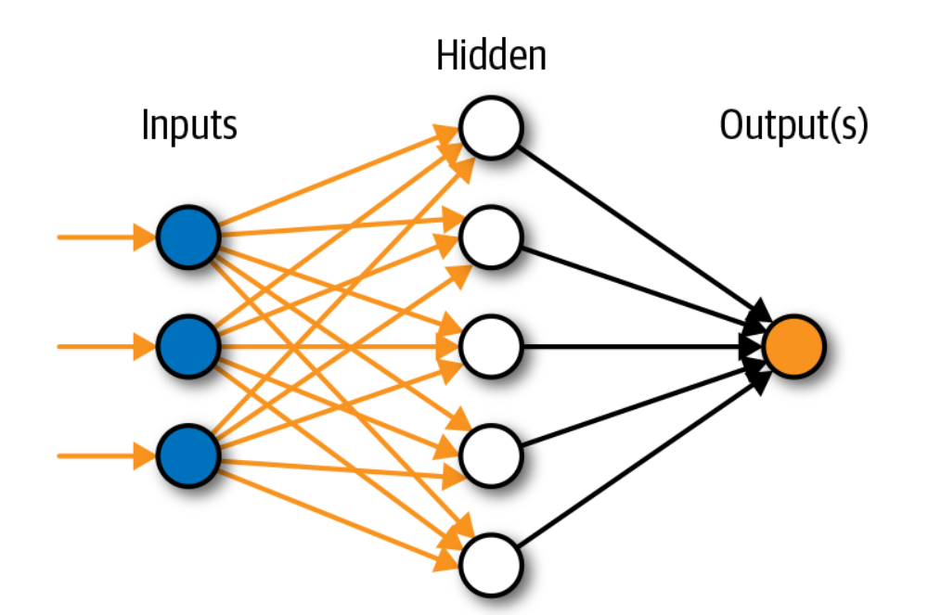
Course Introduction Continued
Artificial Neural Networks:
Artificial Neural Networks:
Interconnections of computing systems/processing units based on Biological neural system(BNN or BNS)
Image Source:https://www.innoarchitech.com/blog/artificial-intelligence-deep-learning-neural-networks-explained

Slide 5
Course Introduction Continued.,
Need for Artificial Neural Networks(ANN):
To develop a Fault Tolerant System
Ability to learn
Ability to model Non Linear & Complex problems
To perform Regression analysis or Function Approximation
Classification and Clustering Analysis
Data Analytics, Data Processing, Data Compression
Robotics Path calculations
Control / Process applications
Artificial Neural Networks are mainly used for Generalization
Artificial Neural Networks is the main tool used in Artificial Intelligence/Natural Language Processing etc.

Slide 6
Course Introduction Continued.,
Applications of Artificial Neural Networks(ANN):
Astronomy & Space Exploration
Communication systems design and development
Credit Rating / Targeted Marketing
Defence R&D
Financial forecasting & Portfolio Management
Fraud Detection / Forensic Applications
Intelligent Searching
Medical Field
Machine Diagnostics
Process modelling and Control
Robotics Path calculations

Slide 7
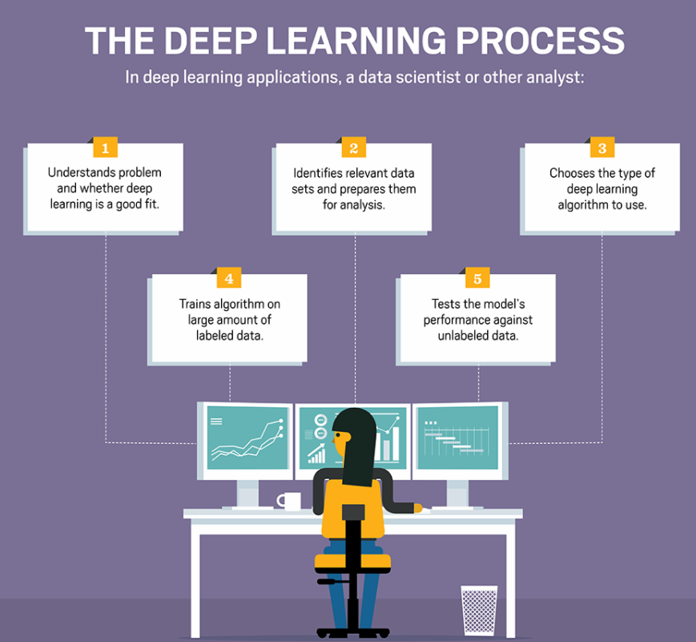
Course Introduction Continued
Part-2:
What is Deep Learning (DL)?
It is a machine learning technique that teaches computers to do what comes naturally to humans: learn by example – [Courtesy: WWW. Mathworks.com]
Image Source: https://searchenterpriseai.techtarget.com/definition/deep-learning-deep-neural-network

Slide 8
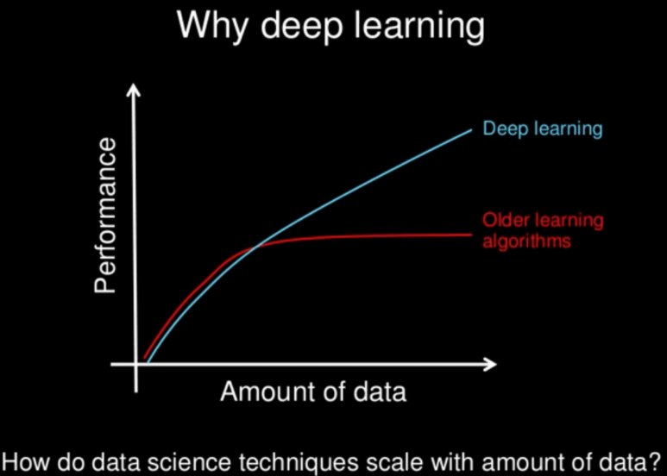
Course Introduction Continued.,
Need for Deep Learning (DL):
Powered by Massive amounts of data
Flexible system
No need for a separate Feature Extraction module
Tolerant to Imprecise Data
Model Nonlinear Functions of higher complex nature
No need for human supervision as like ML
Can be Blended easily into Traditional Control applications
Deep Learning is based on Artificial Neural Networks (ANN)
Deep Learning uses Multiple layers of ANN(Hidden layers)
Image Source: https://machinelearningmastery.com/what-is-deep-learning/

Slide 9
Course Introduction Continued.,
Applications of Deep Learning (DL):
Image/ Pattern Classification
Image/ Pattern Association
Self Driving Cars
News Aggregation and Fraud News Detection
Natural Language Processing
Visual Recognition
Fraud Detection
Healthcare
Automatic Handwriting Generation
Automatic Game Playing
Language Translations
Demographic and Election Predictions

Slide 10
Course Outcomes
SECA4002 – DEEP LEARNING NEURAL NETWORKS
At The end of this Course, Student will be able to
CO1 | Select suitable model parameters for different machine learning techniques
CO2 | Evaluate the performance of existing deep learning models for various applications
CO3 | Realign high dimensional data using reduction techniques
CO4 | Analyze the performance of various optimization and generalization techniques in deep learning
CO5 | Modify the existing architectures for domain specific applications
CO6 | Develop a real time application using deep learning neural networks

Slide 11
Course Objectives
SECA4002 – DEEP LEARNING NEURAL NETWORKS
Course Objectives:
To present the mathematical, statistical and computational challenges of building neural networks
To study the concepts of deep learning
To introduce dimensionality reduction techniques
To enable the students to know deep learning techniques to support real-time applications
To examine the case studies of deep learning techniques

Slide 12
SECA4002 – DEEP LEARNING NEURAL NETWORKS
Detailed Syllabus:
UNIT 1: INTRODUCTION TO DEEP LEARNING
Introduction to machine learning- Linear models (SVMs and Perceptron’s, logistic regression)- Intro to Neural Nets: What a shallow network computes- Training a network: loss functions, back propagation and stochastic gradient descent- Neural networks as universal function approximates

Slide 13
SECA4002 – DEEP LEARNING NEURAL NETWORKS
Detailed Syllabus:
UNIT 2: DEEP NETWORKS
History of Deep Learning- A Probabilistic Theory of Deep Learning- Backpropagation and regularization, batch normalization- VC Dimension and Neural Nets-Deep Vs Shallow Networks Convolutional Networks- Generative Adversarial Networks (GAN), Semi-supervised Learning
UNIT 3: DEEP NETWORKS
Linear (PCA, LDA) and manifolds, metric learning - Auto encoders and dimensionality reduction in networks - Introduction to Convnet - Architectures – AlexNet, VGG, Inception, ResNet - Training a Convnet: weights initialization, batch normalization, hyperparameter optimization

Slide 14
SECA4002 – DEEP LEARNING NEURAL NETWORKS
Detailed Syllabus:
UNIT 4: OPTIMIZATION AND GENERALIZATION
Optimization in deep learning– Non-convex optimization for deep networks- Stochastic Optimization Generalization in neural networks- Spatial Transformer Networks- Recurrent networks, LSTM Recurrent Neural Network Language Models- Word-Level RNNs & Deep Reinforcement Learning - Computational & Artificial Neuroscience
UNIT 3: APPLICATIONS OF DEEP LEARNING
Imagenet- Detection-Audio WaveNet- Natural Language Processing Word2Vec - Joint Detection BioInformatics- Face Recognition- Scene Understanding- Gathering Image Captions

Slide 15
SECA4002 – DEEP LEARNING NEURAL NETWORKS
Recommended Text Books/ Reference Books
Cosma Rohilla Shalizi, Advanced Data Analysis from an Elementary Point of View, 2015.
Deng & Yu, Deep Learning: Methods and Applications, Now Publishers, 2013.
Ian Goodfellow, Yoshua Bengio, Aaron Courville, Deep Learning, MIT Press, 2016.
Michael Nielsen, Neural Networks and Deep Learning, Determination Press, 2015.

Slide 16
UNIT-1 Introduction To Machine Learning

Slide 17
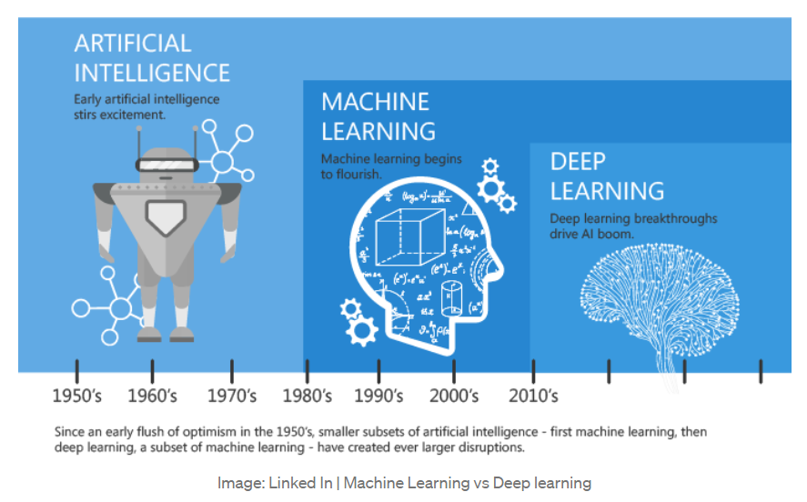
Introduction - Machine Learning

Slide 18
Introduction - Machine Learning
The term Machine Learning was coined by Arthur Samuel in 1959
Machine learning is a specific subset of AI that trains a machine how to learn
Machine learning is a branch of artificial intelligence (AI) and computer science which focuses on the use of data and algorithms to imitate the way that humans learn, gradually improving its accuracy. (Courtesy: www.ibm.com)
Machine learning algorithms use computational methods to “learn” information directly from data without relying on a predetermined equation as a model. The algorithms adaptively improve their performance as the number of samples available for learning increases.

Slide 19
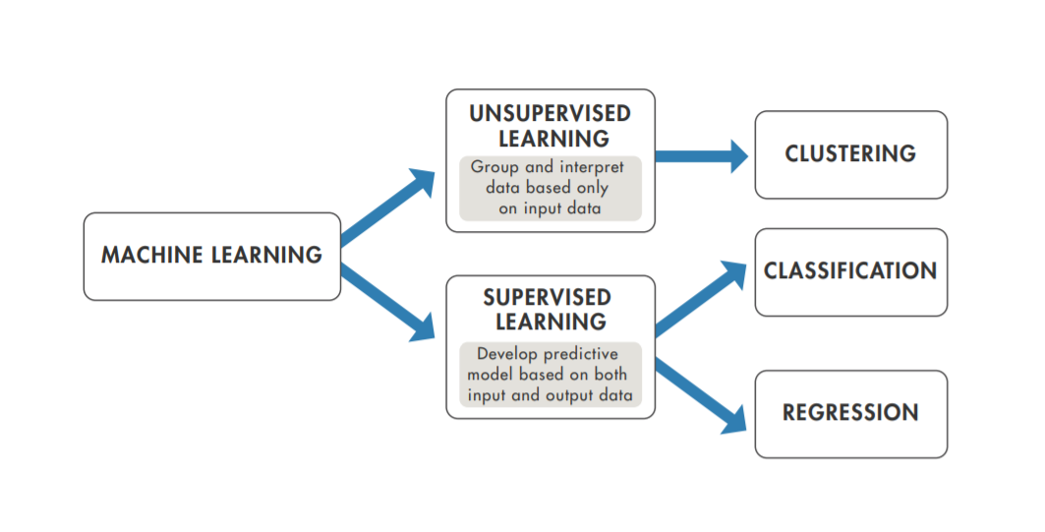
Introduction - Machine Learning
How Machine Learning (ML) Works?
Courtesy: https://in.mathworks.com/content/dam/mathworks/ebook/gated/machine-learning-ebook-all-chapters.pdf

Slide 20
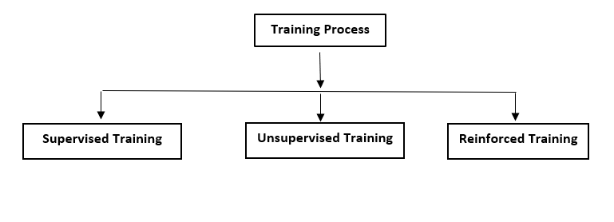
ARTIFICIAL NEURAL NETWORK(ANN)
Training Process
Training process of an Artificial Neural Networks can be broadly classified as
Supervised Training
Unsupervised Training
Reinforced Training

Slide 21
Supervised Learning
Supervised Learning is the process of an learning(from the training dataset) can be thought of as a teacher who is supervising the entire learning process
Learning algorithm iteratively makes predictions on the training data and is corrected by the “teacher”, and the learning stops when the algorithm achieves an acceptable level of performance(or the desired accuracy)
Supervised learning is the learning of the model where with input variable ( say, X) and an output variable (say, Y) and an algorithm to map the input to the output. Y = f(X)

Slide 22
Supervised Training Algorithms
Any Algorithm which implements the supervised Training process is called Supervised Training Algorithms
Key Points:
Each Input Vector is allotted with a corresponding Target vector
The training Pair =[Input vector, Target Vector]
Weights are adjusted to minimize the Difference between the Actual output & the Desired outputs
Actual output = Output provided by the ANN
Desired output = Output specified by the user (Target)

Slide 23
Supervised Training Algorithms- Continued
Supervised Training Procedure
Explanation:
Assume that a teacher is present
Network is provided with the inputs & its associated outputs
After processing based on Learning Law the network provides the output(Actual output)
This out is compared with the Desired (Target) value
If the desired value is Not Equal to the actual output ,then the teacher informs that an error has occurred error
Now the teachers helps us in changing the weight (Based on learning Law)
The process of Weight updating is continued until the desired output is Equal to the actual output ( Stop Condition of the training Algorithm)

Slide 24
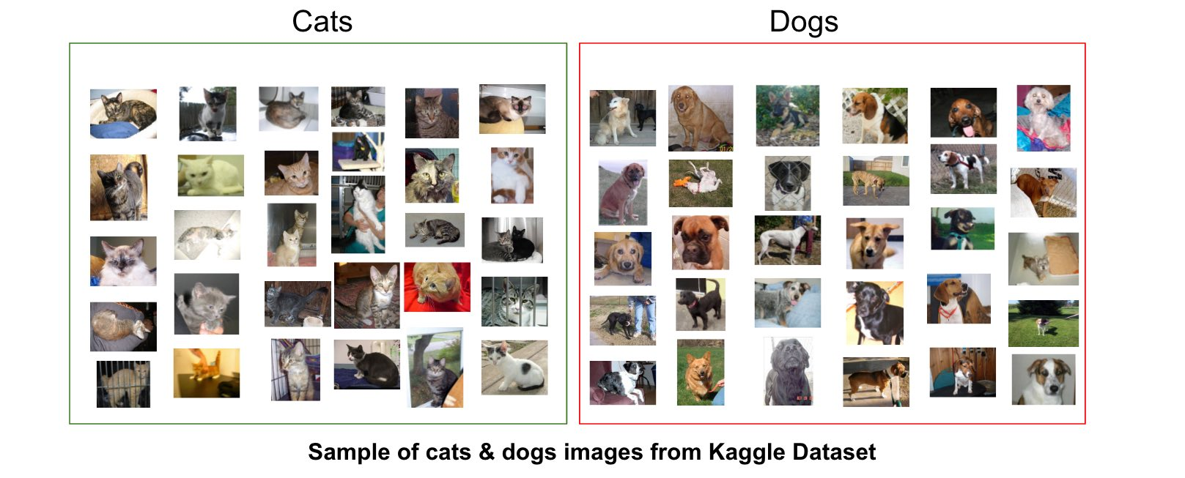
Supervised Learning

Slide 25
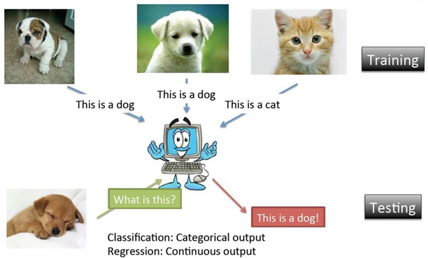
Supervised Learning

Slide 26
Unsupervised Training Algorithms
Any Algorithm which implements the Unsupervised Training process is called Unsupervised Training Algorithms
Key Points:
No Target is provided
Let to discover the target pattern on its own
No Teacher (Error detecting mechanism) is present
Iterative process
Consumes more time to converge(stop condition)
More Accurate when compared with Supervised Training procedure
Used to group unstructured data based on distinct features available within the data set

Slide 27
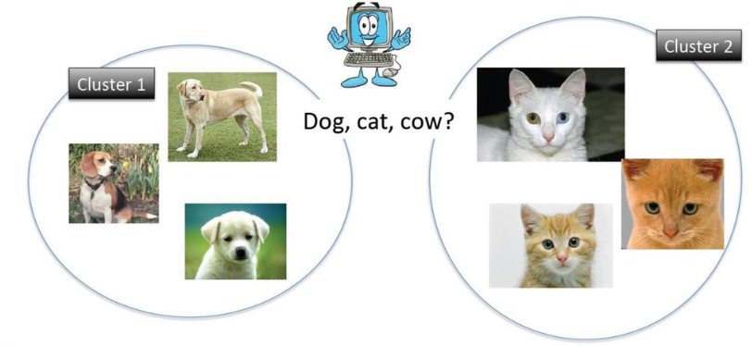
Unsupervised Learning

Slide 28
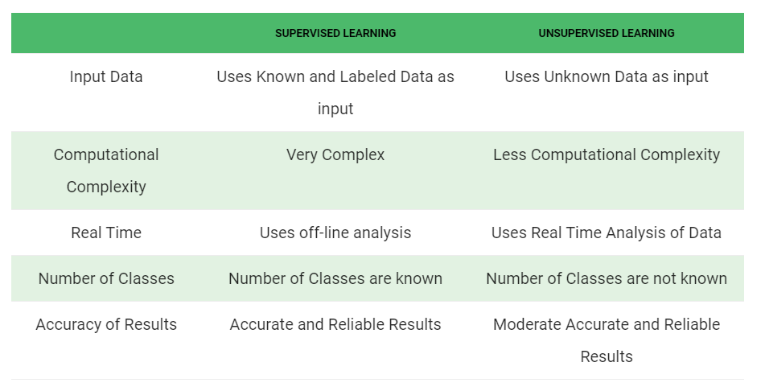
Comparison Between Supervised & Supervised

Slide 29
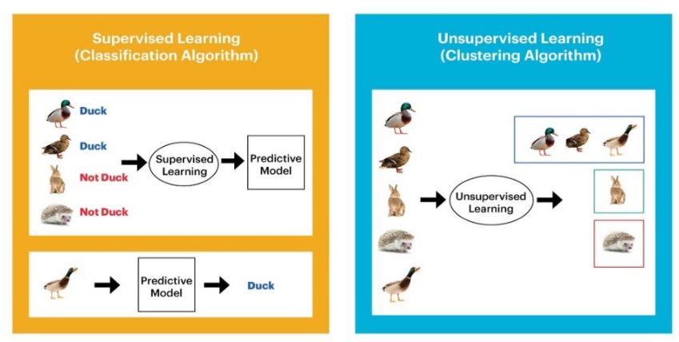
Comparison Between Supervised & Supervised

Slide 30
Reinforced Training Algorithms
Any Algorithm which implements the Unique learning process in which the data’s are not given, but generated by interactions with the environment is called Reinforced Training Algorithms
Points to Ponder:
A teacher is present but does not specifies the Target
The teacher just specifies the obtained output has correct or not
Error detection is present but no error correction
A reward is provided if the output is correct
A penalty is provided for wrong answer
Aim is to maximize the reward process by Trail & error process
The network has to exploit what it already knows in order to obtain reward
It also has to explore new unknown searches in order to make better action selections in the future

Slide 31
Reinforced Learning
Reinforcement learning differs from the supervised learning
In supervised learning the training data has the answer key with it so the model is trained with the correct answer itself
In reinforcement learning, there is no answer but the reinforcement agent decides the action to be done based on the current state/Environment
Agent interprets based on the given input
If the action is good/best then a reward is provided
Unsupervised learning is done
Else a penalty is given
Supervised learning is done i.e weights are changed based on the error

Slide 32
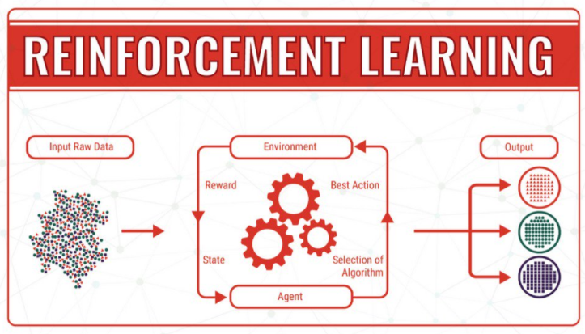
Reinforced Learning
Image source: https://twitter.com/ipfconline1/status/1034281946380218369/photo/1

Slide 33
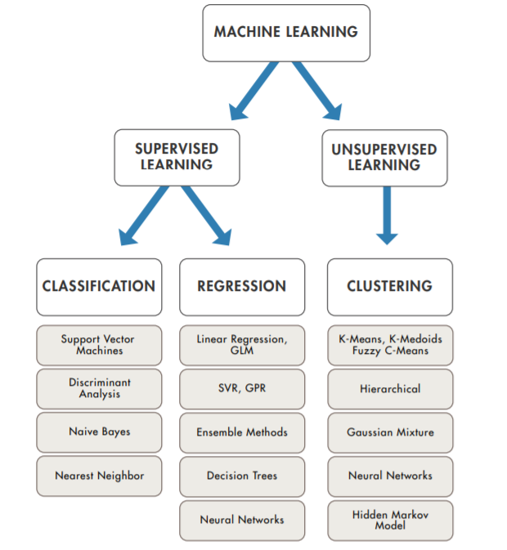
Introduction – Contd.,
How Do You Decide Which Algorithm to Use?
Courtesy: https://in.mathworks.com/content/dam/mathworks/ebook/gated/machine-learning-ebook-all-chapters.pdf

Slide 34
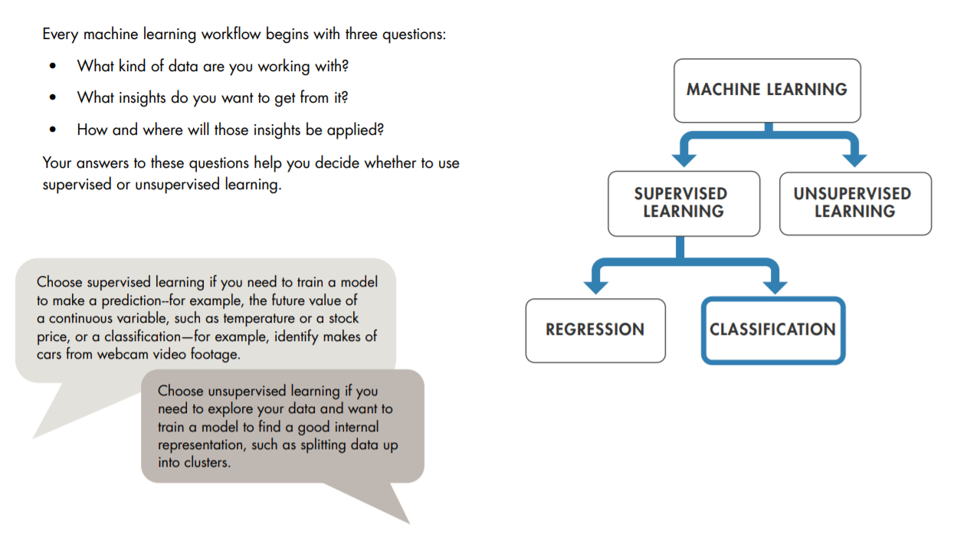
Questions to Consider Before You Start
Courtesy: https://in.mathworks.com/content/dam/mathworks/ebook/gated/machine-learning-ebook-all-chapters.pdf

Slide 35
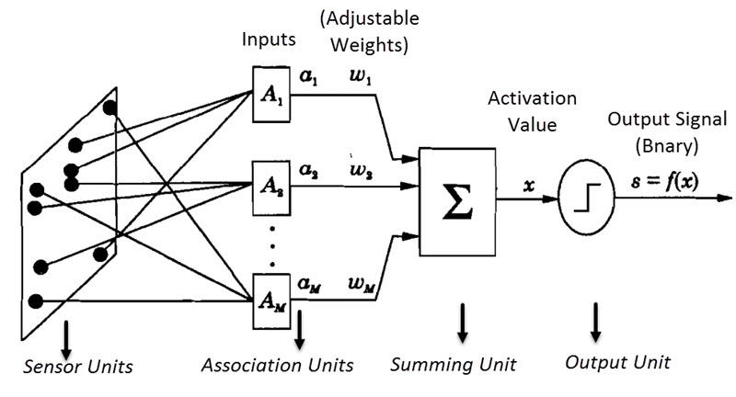
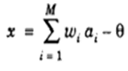
Models of ANN contd.
I. Perceptron Model
I. a. Single Layer Perceptron Model
Activation Function
Output Signal s = f(x)
Error δ = b-s
Weight change Δw= η δ a_{i}

Slide 36
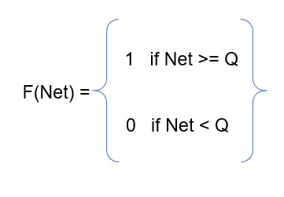
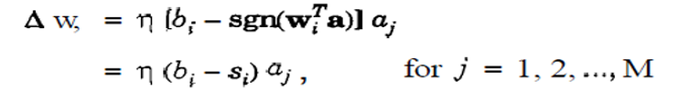
Single Layer Perceptron Model Algorithm
Algorithm:
Initialize the weights to some small random values near to Zero
Apply the Input : Output Training patterns ( Vector Pairs)
Calculate the summing part value Net = Σ aiwi-θ
Apply Activation function and calculate the output
_{Calculate the Error} δ = b_{i}-Si , if error is present then update the weight for that link using

Slide 37
Single Layer Perceptron Model Algorithm
Algorithm ( Continued)
6. Similarly change the Bias values
New Bias = old Bias + change in Bias
7. Now repeat from step 3
8. Check for error ,if error is present repeat the process ,Else Stop
Limitations:
Uses only Binary Activation function
Can be used only for Linear Networks
Since uses Supervised Learning ,Optimal Solution is provided
Training Time is More
Cannot solve Linear In-separable Problem
In order to solve these limitations, Multi Layer Perceptron is Implemented

Slide 38
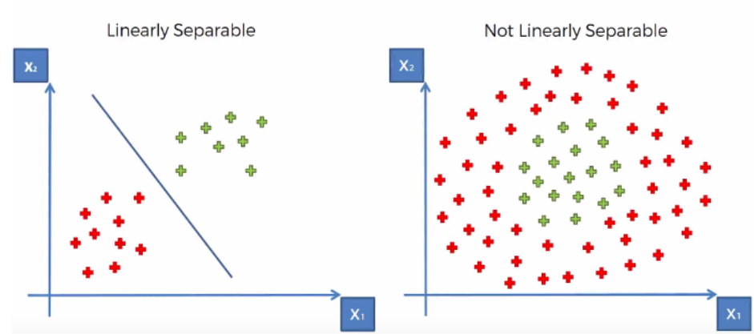
Linear separable & Linear Inseparable issue
Let us consider AND Gate as example for Linear separable and XOR Gate for Linear Inseparability

Slide 39
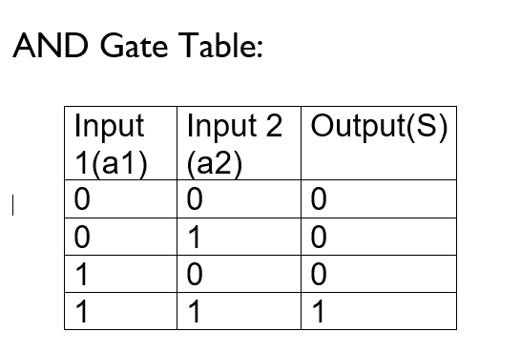
Linear separable & Linear Inseparable issue
1,1
1,0
Decision Boundary Line
B₀+w₁x₁+w₂x₂ =0
w₂x₂ = - B₀ - w₁x₁
X₂ = - B₀ - w₁ x₁
w₂ w₂
0,0
This equation is similar to Line equation
0,1
Let us consider AND Gate as example for Linear separable analysis
Denotes a Binary Value of ‘1’
Denotes a Binary Value of ‘0’

Slide 40
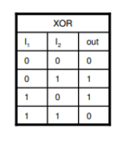
Linear separable & Linear Inseparable issue
Let us consider XOR Gate for Linear Inseparability
1,1
1,0
Denotes a Binary Value of ‘1’
Denotes a Binary Value of ‘0’
0,0
0,1
Here a single decision Line cannot separate the Zeros and Ones Linearly
At least Two lines are required to separate Zeros and Ones
With Single Layer networks we can have only one decision Line, so to solve non Linearity or Linear Inseparable problems Single Layer Networks cannot be used
To Overcome this Problem We use Convex Regions

Slide 41
Linear separable & Linear Inseparable issue
Convex Region:
Select any Two points in a region and draw a straight line between these two points. If the points selected and the lines joining them both lie inside the region then that region is known as convex regions
Types:
(a) Open Convex region (b) Closed Convex Region
To over come Linear Inseparable problem we need at least minimum two or more decision lines, Hence we move towards Multi Layer Networks

Slide 42
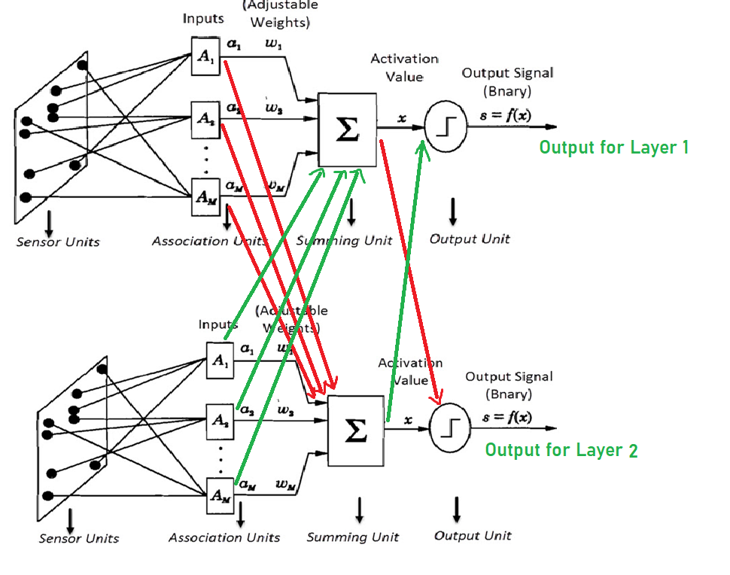
I. Perceptron Model
II. b. Multi Layer Perceptron Model

Slide 43
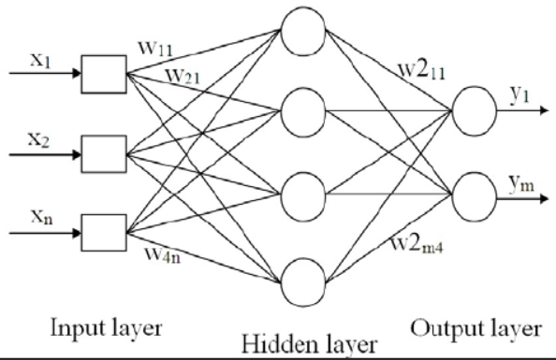
I. b. Multi Layer Perceptron Model
Activation Function
Output Signal s = f(x)
Error δ = b-s
Weight change Δw= η δ a_{i}

Slide 44
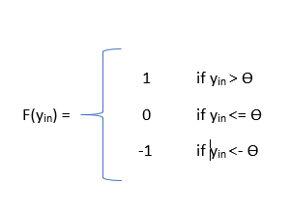
II. b. Multi Layer Perceptron Model
Algorithm:
Initialize the weights (W_{i}) & Bias (B₀) to small random values near Zero
Set learning rate η or α in the range of “0” to “1”
Check for stop condition. If stop condition is false do steps 3 to 7
For each Training pairs do step 4 to 7
Set activations of Output units: x_{i} = s_{i} for i=1 to N
Calculate the output Response
y_{in} = b₀ + Σ x_{i}w_{i}
Activation function is
For Multi Layer networks, based on the number of layers steps 6 & 7 are repeated
Y =
Bipolar Activation is used

Slide 45
I. b. Multi Layer Perceptron Model
Algorithm: (Continued)
If the Targets is (not equal to) = to the actual output (Y), then update weights and bias based on Perceptron Learning Law
W_{i (new)} = W_{i (old)} + Change in weight vector
Change in weight vector = ηt_{i}x_{i}
Where η = Learning Rate
t_{i} = Target output of i^{th} unit
x_{i} = i^{th} Input vector
b_{0(new)} = b_{0 (old)} + Change in Bias
Change in Bias = ηt_{i}
Else W_{i (new)} = W_{i (old)}
b_{0(new)} = b_{0 (old)}
9. Test for Stop condition

Slide 46
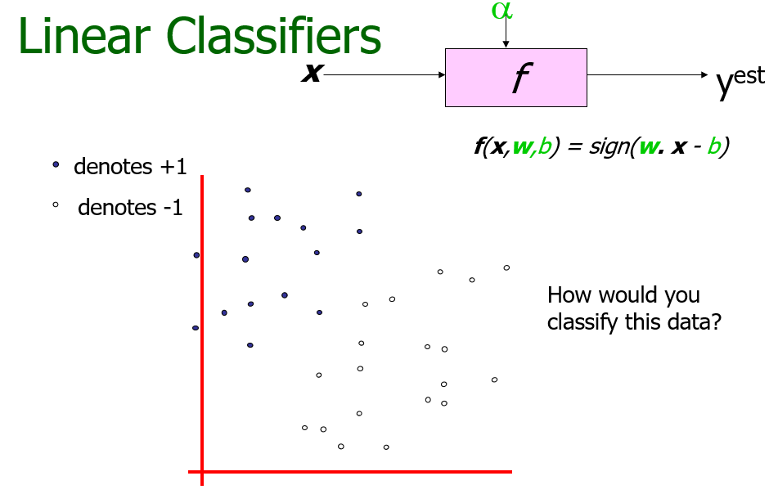
Support Vector Machines (SVM)
Courtesy: (1) http://www.cs.cmu.edu/~awm/tutorials
(2) Copyright © 2001, 2003, Andrew W. Moore

Slide 47
Linear Classifiers
α
x
f
y^{est}
f(x,w,b) = sign(w. x - b)
denotes +1
denotes -1
How would you classify this data?
Courtesy: (1) http://www.cs.cmu.edu/~awm/tutorials
(2) Copyright © 2001, 2003, Andrew W. Moore

Slide 48
Linear Classifiers
α
x
f
y^{est}
f(x,w,b) = sign(w. x - b)
denotes +1
denotes -1
How would you classify this data?
Courtesy: (1) http://www.cs.cmu.edu/~awm/tutorials
(2) Copyright © 2001, 2003, Andrew W. Moore

Slide 49
Linear Classifiers
α
x
f
y^{est}
f(x,w,b) = sign(w. x - b)
denotes +1
denotes -1
How would you classify this data?
Courtesy: (1) http://www.cs.cmu.edu/~awm/tutorials
(2) Copyright © 2001, 2003, Andrew W. Moore

Slide 50
Linear Classifiers
α
x
f
y^{est}
f(x,w,b) = sign(w. x - b)
denotes +1
denotes -1
Any of these would be fine..
..but which is best?
Courtesy: (1) http://www.cs.cmu.edu/~awm/tutorials
(2) Copyright © 2001, 2003, Andrew W. Moore

Slide 51
Classifier Margin
α
x
f
y^{est}
f(x,w,b) = sign(w. x - b)
denotes +1
denotes -1
Define the margin of a linear classifier as the width that the boundary could be increased by before hitting a datapoint.
Courtesy: (1) http://www.cs.cmu.edu/~awm/tutorials
(2) Copyright © 2001, 2003, Andrew W. Moore

Slide 52
Maximum Margin
α
x
f
y^{est}
f(x,w,b) = sign(w. x - b)
denotes +1
denotes -1
The maximum margin linear classifier is the linear classifier with the, um, maximum margin.
This is the simplest kind of SVM (Called an LSVM)
Linear SVM
Courtesy: (1) http://www.cs.cmu.edu/~awm/tutorials
(2) Copyright © 2001, 2003, Andrew W. Moore

Slide 53
Maximum Margin
α
x
f
y^{est}
f(x,w,b) = sign(w. x - b)
denotes +1
denotes -1
The maximum margin linear classifier is the linear classifier with the, um, maximum margin.
This is the simplest kind of SVM (Called an LSVM)
Support Vectors are those datapoints that the margin pushes up against
Linear SVM
Courtesy: (1) http://www.cs.cmu.edu/~awm/tutorials
(2) Copyright © 2001, 2003, Andrew W. Moore

Slide 54
Why Maximum Margin?
Intuitively this feels safest.
If we’ve made a small error in the location of the boundary (it’s been jolted in its perpendicular direction) this gives us least chance of causing a misclassification.
LOOCV is easy since the model is immune to removal of any non-support-vector datapoints.
There’s some theory (using VC dimension) that is related to (but not the same as) the proposition that this is a good thing.
Empirically it works very very well.
f(x,w,b) = sign(w. x - b)
denotes +1
denotes -1
The maximum margin linear classifier is the linear classifier with the, um, maximum margin.
This is the simplest kind of SVM (Called an LSVM)
Support Vectors are those datapoints that the margin pushes up against
Courtesy: (1) http://www.cs.cmu.edu/~awm/tutorials
(2) Copyright © 2001, 2003, Andrew W. Moore

Slide 55
Specifying a line and margin
Plus-Plane
“Predict Class = +1” zone
Classifier Boundary
Minus-Plane
“Predict Class = -1” zone
How do we represent this mathematically?
…in m input dimensions?
Courtesy: (1) http://www.cs.cmu.edu/~awm/tutorials
(2) Copyright © 2001, 2003, Andrew W. Moore

Slide 56
Specifying a line and margin
Plus-Plane
“Predict Class = +1” zone
Classifier Boundary
Minus-Plane
“Predict Class = -1” zone
wx+b=1
wx+b=0
wx+b=-1
Plus-plane = { x : w . x + b = +1 }
Minus-plane = { x : w . x + b = -1 }
Classify as.. | +1 | if | w . x + b >= 1
 | -1 | if | w . x + b <= -1
 | Universe explodes | if | -1 < w . x + b < 1
Courtesy: (1) http://www.cs.cmu.edu/~awm/tutorials
(2) Copyright © 2001, 2003, Andrew W. Moore

Slide 57
Computing the margin width
M = Margin Width
“Predict Class = +1” zone
How do we compute M in terms of w and b?
“Predict Class = -1” zone
wx+b=1
wx+b=0
wx+b=-1
Plus-plane = { x : w . x + b = +1 }
Minus-plane = { x : w . x + b = -1 }
Claim: The vector w is perpendicular to the Plus Plane. Why?
Courtesy: (1) http://www.cs.cmu.edu/~awm/tutorials
(2) Copyright © 2001, 2003, Andrew W. Moore

Slide 58
Computing the margin width
M = Margin Width
“Predict Class = +1” zone
How do we compute M in terms of w and b?
“Predict Class = -1” zone
wx+b=1
wx+b=0
wx+b=-1
Plus-plane = { x : w . x + b = +1 }
Minus-plane = { x : w . x + b = -1 }
Claim: The vector w is perpendicular to the Plus Plane. Why?
Let u and v be two vectors on the Plus Plane. What is w . ( u – v ) ?
And so of course the vector w is also perpendicular to the Minus Plane
Courtesy: (1) http://www.cs.cmu.edu/~awm/tutorials
(2) Copyright © 2001, 2003, Andrew W. Moore

Slide 59
Computing the margin width
x⁺
M = Margin Width
“Predict Class = +1” zone
How do we compute M in terms of w and b?
x⁻
“Predict Class = -1” zone
wx+b=1
wx+b=0
wx+b=-1
Plus-plane = { x : w . x + b = +1 }
Minus-plane = { x : w . x + b = -1 }
The vector w is perpendicular to the Plus Plane
Let x⁻ be any point on the minus plane
Let x⁺ be the closest plus-plane-point to x⁻.
Any location in ^{m}: not necessarily a datapoint
Any location in R^{m}: not necessarily a datapoint
Courtesy: (1) http://www.cs.cmu.edu/~awm/tutorials
(2) Copyright © 2001, 2003, Andrew W. Moore

Slide 60
Computing the margin width
x⁺
M = Margin Width
“Predict Class = +1” zone
How do we compute M in terms of w and b?
x⁻
“Predict Class = -1” zone
wx+b=1
wx+b=0
wx+b=-1
Plus-plane = { x : w . x + b = +1 }
Minus-plane = { x : w . x + b = -1 }
The vector w is perpendicular to the Plus Plane
Let x⁻ be any point on the minus plane
Let x⁺ be the closest plus-plane-point to x⁻.
Claim: x⁺ = x⁻ + λ w for some value of λ. Why?
Courtesy: (1) http://www.cs.cmu.edu/~awm/tutorials
(2) Copyright © 2001, 2003, Andrew W. Moore

Slide 61
Computing the margin width
x⁺
M = Margin Width
“Predict Class = +1” zone
The line from x⁻ to x⁺ is perpendicular to the planes.
So to get from x⁻ to x⁺ travel some distance in direction w.
How do we compute M in terms of w and b?
x⁻
“Predict Class = -1” zone
wx+b=1
wx+b=0
wx+b=-1
Plus-plane = { x : w . x + b = +1 }
Minus-plane = { x : w . x + b = -1 }
The vector w is perpendicular to the Plus Plane
Let x⁻ be any point on the minus plane
Let x⁺ be the closest plus-plane-point to x⁻.
Claim: x⁺ = x⁻ + λ w for some value of λ. Why?
Courtesy: (1) http://www.cs.cmu.edu/~awm/tutorials
(2) Copyright © 2001, 2003, Andrew W. Moore

Slide 62
Computing the margin width
x⁺
M = Margin Width
“Predict Class = +1” zone
x⁻
“Predict Class = -1” zone
wx+b=1
wx+b=0
wx+b=-1
What we know:
w . x⁺ + b = +1
w . x⁻ + b = -1
x⁺ = x⁻ + λ w
|x⁺ - x⁻ | = M
It’s now easy to get M in terms of w and b
Courtesy: (1) http://www.cs.cmu.edu/~awm/tutorials
(2) Copyright © 2001, 2003, Andrew W. Moore

Slide 63
Computing the margin width
x⁺
M = Margin Width
“Predict Class = +1” zone
x⁻
“Predict Class = -1” zone
wx+b=1
wx+b=0
w . (x ⁻ + λ w) + b = 1
=>
w . x ⁻ + b + λ w .w = 1
=>
-1 + λ w .w = 1
=>
wx+b=-1
What we know:
w . x⁺ + b = +1
w . x⁻ + b = -1
x⁺ = x⁻ + λ w
|x⁺ - x⁻ | = M
It’s now easy to get M in terms of w and b
Courtesy: (1) http://www.cs.cmu.edu/~awm/tutorials
(2) Copyright © 2001, 2003, Andrew W. Moore

Slide 64
Computing the margin width
x⁺
M = Margin Width =
“Predict Class = +1” zone
x⁻
“Predict Class = -1” zone
wx+b=1
wx+b=0
M = |x⁺ - x⁻ | =| λ w |=
wx+b=-1
What we know:
w . x⁺ + b = +1
w . x⁻ + b = -1
x⁺ = x⁻ + λ w
|x⁺ - x⁻ | = M
Courtesy: (1) http://www.cs.cmu.edu/~awm/tutorials
(2) Copyright © 2001, 2003, Andrew W. Moore

Slide 65
Learning the Maximum Margin Classifier
x⁺
M = Margin Width =
“Predict Class = +1” zone
x⁻
“Predict Class = -1” zone
wx+b=1
wx+b=0
wx+b=-1
Given a guess of w and b we can
Compute whether all data points in the correct half-planes
Compute the width of the margin
So now we just need to write a program to search the space of w’s and b’s to find the widest margin that matches all the datapoints. How?
Gradient descent? Simulated Annealing? Matrix Inversion? EM? Newton’s Method?
Courtesy: (1) http://www.cs.cmu.edu/~awm/tutorials
(2) Copyright © 2001, 2003, Andrew W. Moore

Slide 66
Learning via Quadratic Programming
QP is a well-studied class of optimization algorithms to maximize a quadratic function of some real-valued variables subject to linear constraints.
Courtesy: (1) http://www.cs.cmu.edu/~awm/tutorials
(2) Copyright © 2001, 2003, Andrew W. Moore

Slide 67
Quadratic Programming
Find
Quadratic criterion
Subject to
n additional linear inequality constraints
And subject to
e additional linear equality constraints
Courtesy: (1) http://www.cs.cmu.edu/~awm/tutorials
(2) Copyright © 2001, 2003, Andrew W. Moore

Slide 68
Quadratic Programming
Find
Quadratic criterion
There exist algorithms for finding such constrained quadratic optima much more efficiently and reliably than gradient ascent.
(But they are very fiddly…you probably don’t want to write one yourself)
Subject to
n additional linear inequality constraints
And subject to
e additional linear equality constraints
Courtesy: (1) http://www.cs.cmu.edu/~awm/tutorials
(2) Copyright © 2001, 2003, Andrew W. Moore

Slide 69
Learning the Maximum Margin Classifier
M =
Given guess of w , b we can
Compute whether all data points are in the correct half-planes
Compute the margin width
Assume R datapoints, each (x_{k},y_{k}) where y_{k} = +/- 1
“Predict Class = +1” zone
“Predict Class = -1” zone
wx+b=1
wx+b=0
wx+b=-1
What should our quadratic optimization criterion be?
How many constraints will we have?
What should they be?
Courtesy: (1) http://www.cs.cmu.edu/~awm/tutorials
(2) Copyright © 2001, 2003, Andrew W. Moore

Slide 70
Learning the Maximum Margin Classifier
M =
Given guess of w , b we can
Compute whether all data points are in the correct half-planes
Compute the margin width
Assume R datapoints, each (x_{k},y_{k}) where y_{k} = +/- 1
“Predict Class = +1” zone
“Predict Class = -1” zone
wx+b=1
wx+b=0
wx+b=-1
How many constraints will we have? R
What should they be?
w . x_{k} + b >= 1 if y_{k} = 1
w . x_{k} + b <= -1 if y_{k} = -1
What should our quadratic optimization criterion be?
Minimize w.w
Courtesy: (1) http://www.cs.cmu.edu/~awm/tutorials
(2) Copyright © 2001, 2003, Andrew W. Moore

Slide 71
Uh-oh!
This is going to be a problem!
What should we do?
denotes +1
denotes -1
Courtesy: (1) http://www.cs.cmu.edu/~awm/tutorials
(2) Copyright © 2001, 2003, Andrew W. Moore

Slide 72
Uh-oh!
This is going to be a problem!
What should we do?
Idea 1:
Find minimum w.w, while minimizing number of training set errors.
Problemette: Two things to minimize makes for an ill-defined optimization
denotes +1
denotes -1
Courtesy: (1) http://www.cs.cmu.edu/~awm/tutorials
(2) Copyright © 2001, 2003, Andrew W. Moore

Slide 73
Uh-oh!
This is going to be a problem!
What should we do?
Idea 1.1:
Minimize
w.w + C (#train errors)
There’s a serious practical problem that’s about to make us reject this approach. Can you guess what it is?
denotes +1
denotes -1
Tradeoff parameter
Courtesy: (1) http://www.cs.cmu.edu/~awm/tutorials
(2) Copyright © 2001, 2003, Andrew W. Moore

Slide 74
Uh-oh!
This is going to be a problem!
What should we do?
Idea 1.1:
Minimize
w.w + C (#train errors)
There’s a serious practical problem that’s about to make us reject this approach. Can you guess what it is?
denotes +1
denotes -1
Tradeoff parameter
Can’t be expressed as a Quadratic Programming problem.
Solving it may be too slow.
(Also, doesn’t distinguish between disastrous errors and near misses)
So… any other ideas?
Courtesy: (1) http://www.cs.cmu.edu/~awm/tutorials
(2) Copyright © 2001, 2003, Andrew W. Moore

Slide 75
Uh-oh!
This is going to be a problem!
What should we do?
Idea 2.0:
Minimize
w.w + C (distance of error
points to their
correct place)
denotes +1
denotes -1
Courtesy: (1) http://www.cs.cmu.edu/~awm/tutorials
(2) Copyright © 2001, 2003, Andrew W. Moore

Slide 76
Learning Maximum Margin with Noise
M =
Given guess of w , b we can
Compute sum of distances of points to their correct zones
Compute the margin width
Assume R datapoints, each (x_{k},y_{k}) where y_{k} = +/- 1
wx+b=1
wx+b=0
wx+b=-1
What should our quadratic optimization criterion be?
How many constraints will we have?
What should they be?
Courtesy: (1) http://www.cs.cmu.edu/~awm/tutorials
(2) Copyright © 2001, 2003, Andrew W. Moore

Slide 77
Learning Maximum Margin with Noise
ε₁₁
M =
Given guess of w , b we can
Compute sum of distances of points to their correct zones
Compute the margin width
Assume R datapoints, each (x_{k},y_{k}) where y_{k} = +/- 1
ε₂
wx+b=1
ε₇
wx+b=0
wx+b=-1
What should our quadratic optimization criterion be?
Minimize
How many constraints will we have? R
What should they be?
w . x_{k} + b >= 1-ε_{k} if y_{k} = 1
w . x_{k} + b <= -1+ε_{k} if y_{k} = -1
Courtesy: (1) http://www.cs.cmu.edu/~awm/tutorials
(2) Copyright © 2001, 2003, Andrew W. Moore

Slide 78
Learning Maximum Margin with Noise
m = # input dimensions
M =
Given guess of w , b we can
Compute sum of distances of points to their correct zones
Compute the margin width
Assume R datapoints, each (x_{k},y_{k}) where y_{k} = +/- 1
ε₁₁
ε₂
Our original (noiseless data) QP had m+1 variables: w₁, w₂, … w_{m}, and b.
Our new (noisy data) QP has m+1+R variables: w₁, w₂, … w_{m}, b, ε_{k} , ε₁ ,… ε_{R}
wx+b=1
ε₇
wx+b=0
wx+b=-1
What should our quadratic optimization criterion be?
Minimize
How many constraints will we have? R
What should they be?
w . x_{k} + b >= 1-ε_{k} if y_{k} = 1
w . x_{k} + b <= -1+ε_{k} if y_{k} = -1
R= # records
Courtesy: (1) http://www.cs.cmu.edu/~awm/tutorials
(2) Copyright © 2001, 2003, Andrew W. Moore

Slide 79
Learning Maximum Margin with Noise
M =
Given guess of w , b we can
Compute sum of distances of points to their correct zones
Compute the margin width
Assume R datapoints, each (x_{k},y_{k}) where y_{k} = +/- 1
ε₁₁
ε₂
wx+b=1
ε₇
wx+b=0
wx+b=-1
What should our quadratic optimization criterion be?
Minimize
How many constraints will we have? R
What should they be?
w . x_{k} + b >= 1-ε_{k} if y_{k} = 1
w . x_{k} + b <= -1+ε_{k} if y_{k} = -1
There’s a bug in this QP. Can you spot it?
Courtesy: (1) http://www.cs.cmu.edu/~awm/tutorials
(2) Copyright © 2001, 2003, Andrew W. Moore

Slide 80
Learning Maximum Margin with Noise
M =
Given guess of w , b we can
Compute sum of distances of points to their correct zones
Compute the margin width
Assume R datapoints, each (x_{k},y_{k}) where y_{k} = +/- 1
ε₁₁
ε₂
wx+b=1
ε₇
wx+b=0
wx+b=-1
What should our quadratic optimization criterion be?
Minimize
How many constraints will we have? 2R
What should they be?
w . x_{k} + b >= 1-ε_{k} if y_{k} = 1
w . x_{k} + b <= -1+ε_{k} if y_{k} = -1
ε_{k} >= 0 for all k
Courtesy: (1) http://www.cs.cmu.edu/~awm/tutorials
(2) Copyright © 2001, 2003, Andrew W. Moore

Slide 81
Suppose we’re in 1-dimension
What would SVMs do with this data?
x=0

Slide 82
Suppose we’re in 1-dimension
Not a big surprise
x=0
Positive “plane”
Negative “plane”
Courtesy: (1) http://www.cs.cmu.edu/~awm/tutorials
(2) Copyright © 2001, 2003, Andrew W. Moore

Slide 83
Harder 1-dimensional dataset
That’s wiped the smirk off SVM’s face.
What can be done about this?
x=0
Courtesy: (1) http://www.cs.cmu.edu/~awm/tutorials
(2) Copyright © 2001, 2003, Andrew W. Moore

Slide 84
Harder 1-dimensional dataset
Remember how permitting non-linear basis functions made linear regression so much nicer?
Let’s permit them here too
x=0
Courtesy: (1) http://www.cs.cmu.edu/~awm/tutorials
(2) Copyright © 2001, 2003, Andrew W. Moore

Slide 85
Harder 1-dimensional dataset
Remember how permitting non-linear basis functions made linear regression so much nicer?
Let’s permit them here too
x=0
Courtesy: (1) http://www.cs.cmu.edu/~awm/tutorials
(2) Copyright © 2001, 2003, Andrew W. Moore

Slide 86
Common SVM basis functions
z_{k} = ( polynomial terms of x_{k} of degree 1 to q )
z_{k} = ( radial basis functions of x_{k} )
z_{k} = ( sigmoid functions of x_{k} )
This is sensible.
Is that the end of the story?
No…there’s one more trick!
Courtesy: (1) http://www.cs.cmu.edu/~awm/tutorials
(2) Copyright © 2001, 2003, Andrew W. Moore

Slide 87
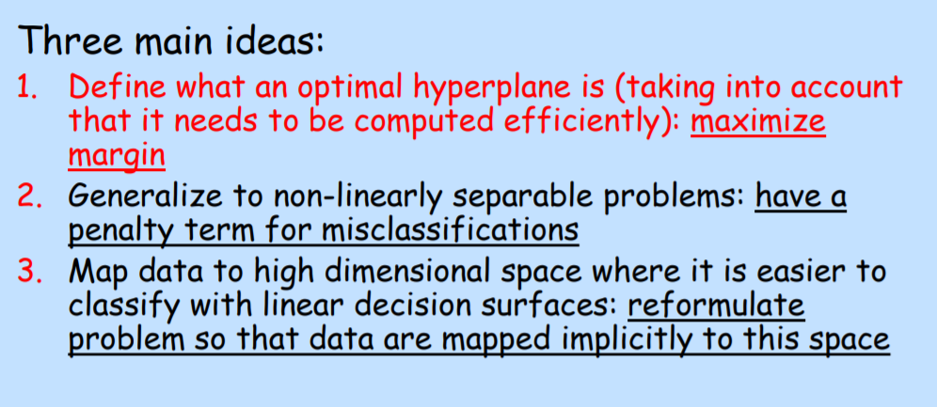
Support Vector Machines (SVM)
Courtesy: http://www.cs.tau.ac.il/~rshamir/abdbm/pres/17/SVM.pdf

Slide 88
Logistic Regressions
What is logistic regression?
Logit -, a specialized form of regression
used when the dependent variable is BInary and categorical while the independent variable(s) could be any type.
Dependent variable is binary (yes/no, Male/Female ) outcome.
Independent variables are continuous interval
Examples:
Relation of weight and BP to 10 year risk of death

Slide 89
Logistic Regressions
What is logistic regression? - Continued
Form of regression that allows the prediction of discrete variables by a mix of continuous and discrete/nominal predictors.
Addresses the same questions that discriminant function analysis and multiple regression do but with no distributional assumptions on the predictors (the predictors do not have to be normally distributed, linearly related or have equal variance in each group)
Does not assume a linear relationship between DV and IV
3

Slide 90
Logistic Regressions
Why we use ?
No assumptions about the distributions of the predictor variables.
Predictors do not have to be normally distributed
Does not have to be linearly related.
When equal variances , covariance doesn't exist across the groups.

Slide 91
Logistic Regressions
Types of Logistic Regression?
BINARY LOGISTIC REGRESSION
It is used when the dependent variable is binary in nature.
MULTINOMIAL LOGISTIC REGRESSION
It is used when the dependent or outcomes variable has more than two categories.

Slide 92
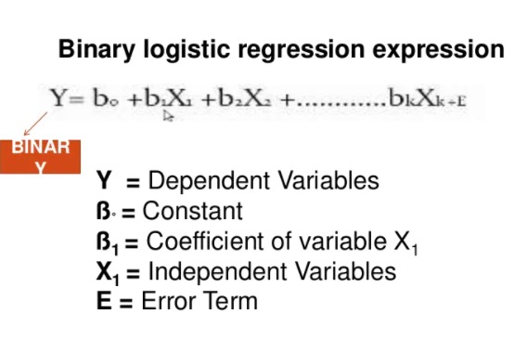
Logistic Regressions

Slide 93
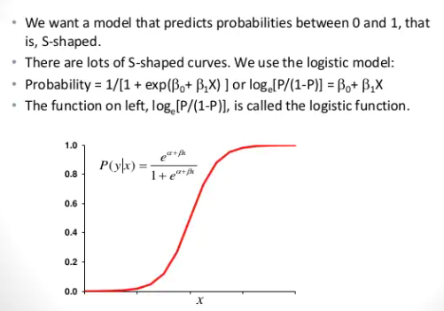
Logistic Regressions

Slide 94
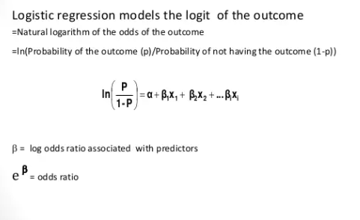
Logistic Regressions

Slide 95
Logistic Regressions
Summary:
Logistic regression is a probabilistic model that classifies the instances in terms of probabilities.
Since the classification is probabilistic, a natural approach for optimizing the parameters is to ensure that the predicted probability of the observed class for each training instance is as large as possible.
This is achieved by using the notion of maximum-likelihood estimation in order to learn the parameters of the model.
The likelihood of the training data is defined as the product of the probabilities of the observed labels of each training instance.
Larger values of this objective function are better.
By using the negative logarithm of this value, one obtains an a loss function in minimization form.
Therefore, the output node uses the negative log-likelihood as a loss function.
This loss function replaces the squared error used in the Widrow-Hoff method.
The output layer can be formulated with the sigmoid activation function, which is very common in neural network design.

Slide 96
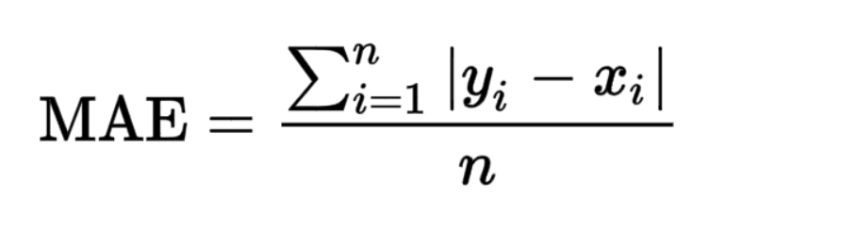
Loss Functions
Loss functions measure how far an estimated value is from its true value.
A loss function maps decisions to their associated costs.
Loss functions are not fixed, they change depending on the task in hand and the goal to be met.
A way to measure how far a particular iteration of the model is from the actual values.
Loss Function for Regressions:
Mean Absolute Error (MAE)
Mean Absolute Error (also called L1 loss) is one of the most simple yet robust loss functions used for regression models.
Defined as the average sum of the absolute differences between the actual and the predicted values.
For a data point x_{i} and its predicted value y_{i}, n being the total number of data points in the dataset, the mean absolute error is defined as:

Slide 97
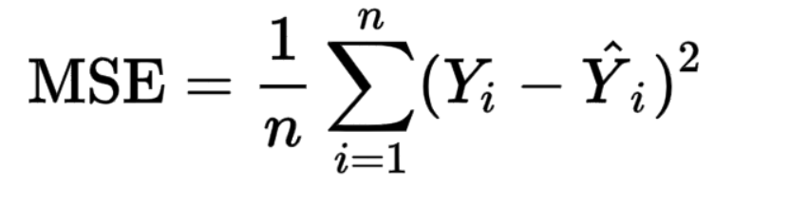
Loss Functions - Regressions
(2) Mean Squared Error (MSE):
Mean Squared Error (also called L2 loss)
Defined as the average of the squared differences between the actual and the predicted values. For a data point Y_{i} and its predicted value Ŷ_{i}, where n is the total number of data points in the dataset, the mean squared error is given as:
(3) Mean Bias Error (MBE):
Mean Bias Error is used to calculate the average bias in the model. Bias, in short, is overestimating or underestimating a parameter.
Mean Bias Error takes the actual difference between the target and the predicted value, and not the absolute difference

Slide 98
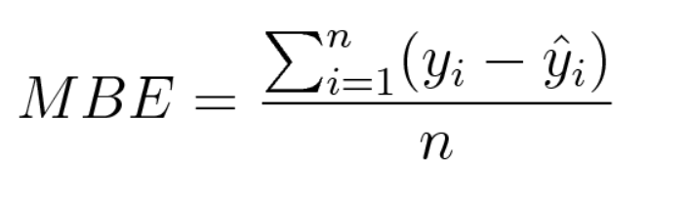
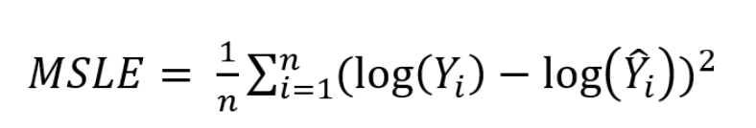
Loss Functions - Regressions
(3) Mean Bias Error (MBE):
One has to be cautious as the positive and the negative errors could cancel each other out, which is why it is one of the lesser-used loss functions
(4) Mean Squared Logarithmic Error (MSLE):
We may not want to penalize the model too much for predicting unscaled quantities directly. Relaxing the penalty on huge differences can be done with the help of Mean Squared Logarithmic Error.
Mean Squared Logarithmic Error is the same as Mean Squared Error, except the natural logarithm of the predicted values is used rather than the actual values

Slide 99
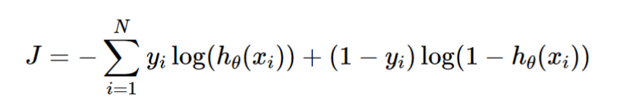
Loss Functions - Classifications
(1) Binary Cross Entropy Loss:
This is the most common loss function used for classification problems that have two classes
Entropy is the measure of randomness in the information being processed, and cross entropy is a measure of the difference of the randomness between two random variables.
Where y_{i} is the true label and h_{θ}(x_{i}) is the predicted value post hypothesis.
Since binary classification means the classes take either 0 or 1, if y_{i} = 0, that term ceases to exist and if y_{i} = 1, the (1-y_{i}) term becomes 0.

Slide 100
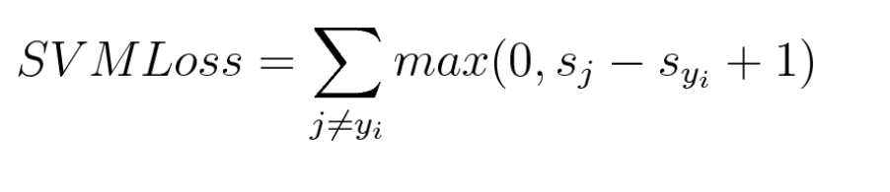
Loss Functions - Classifications
(2) Categorical Cross Entropy Loss:
Categorical Cross Entropy loss is essentially Binary Cross Entropy Loss expanded to multiple classes. One requirement when categorical cross entropy loss function is used is that the labels should be one-hot encoded.
(3) Hinge Loss:
Commonly used loss function for classification is the hinge loss. Hinge loss is primarily developed for support vector machines for calculating the maximum margin from the hyperplane to the classes.
Loss functions penalize wrong predictions and does not do so for the right predictions. So, the score of the target label should be greater than the sum of all the incorrect labels by a margin of (at the least) one.

Slide 101
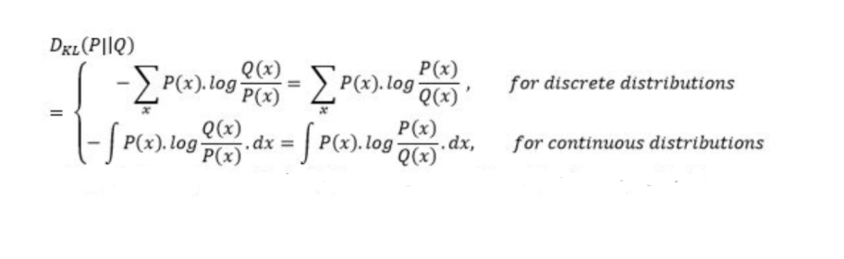
Loss Functions - Classifications
(4) Kullback Leibler Divergence Loss (KL Loss):
Kullback Leibler Divergence Loss is a measure of how a distribution varies from a reference distribution (or a baseline distribution).
A Kullback Leibler Divergence Loss of zero means that both the probability distributions are identical.
The number of information lost in the predicted distribution is used as a measure.

Slide 102
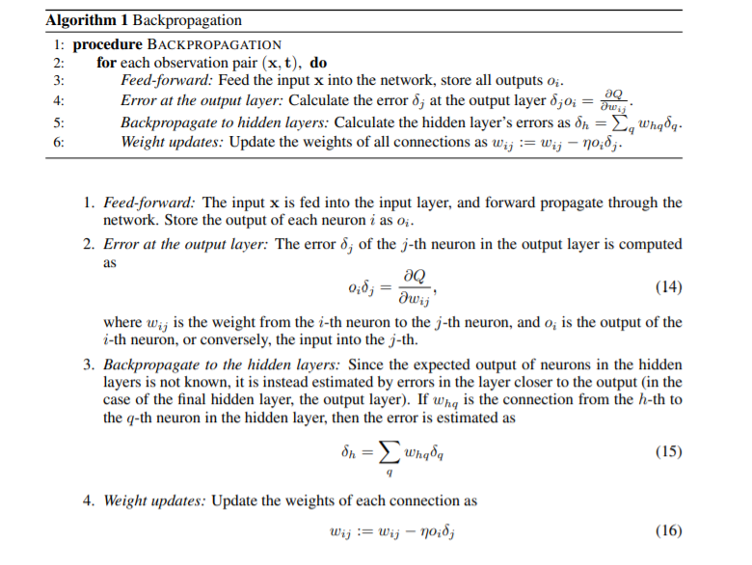
Back Propagation- Algorithm

Slide 103
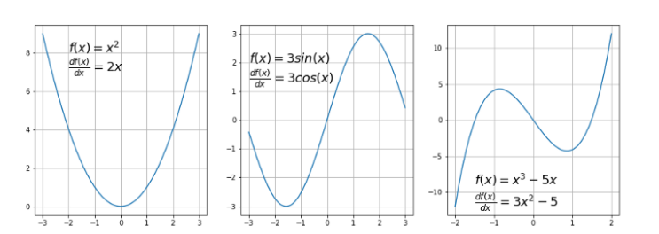
Gradient Descent- Algorithm
Gradient descent (GD) : is an iterative first-order optimization algorithm used to find a local minimum/maximum of a given function. This method is commonly used in machine learning (ML) and deep learning(DL) to minimize a cost/loss function .
Function requirements of GD:
Gradient descent algorithm does not work for all functions. There are two specific requirements. A function has to be:
(1) Differentiable -If a function is differentiable it has a derivative for each point in its domain

Slide 104
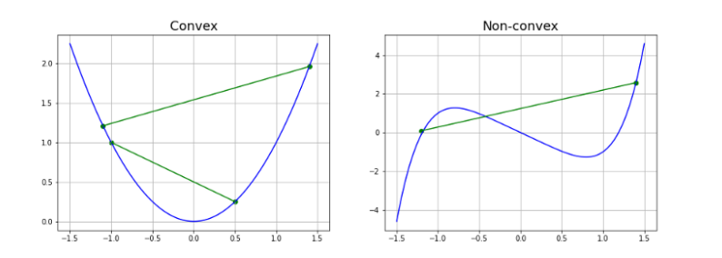
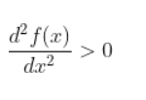
Gradient Descent- Algorithm
(2) Convex -For a univariate function, this means that the line segment connecting two function’s points lays on or above its curve (it does not cross it)
Another way to check mathematically if a univariate function is convex is to calculate the second derivative and check if its value is always bigger than 0.

Slide 105
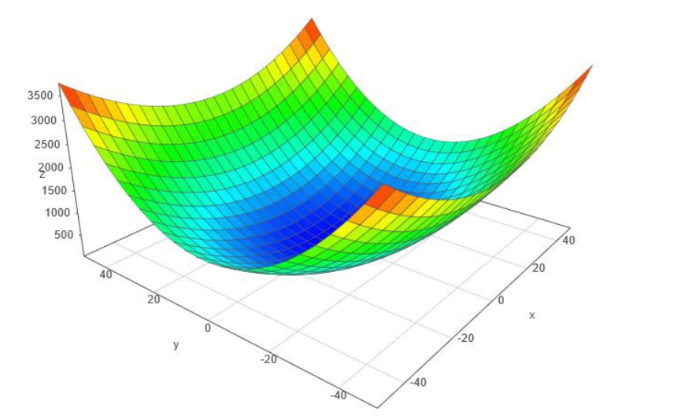
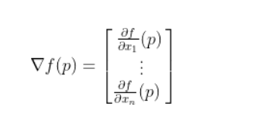
Gradient Descent- Algorithm
Gradient: It is a slope of a curve at a given point in a specified direction.
In the case of a univariate function, it is simply the first derivative at a selected point.
In the case of a multivariate function, it is a vector of derivatives in each main direction (along variable axes).
we are interested only in a slope along one axis and we don’t care about others these derivatives are called partial derivatives.
A gradient for an n-dimensional function f(x) at a given point p is defined as follows:

Slide 106
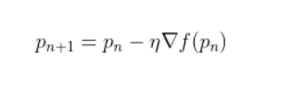
Gradient Descent- Algorithm
Gradient Descent Algorithm iteratively calculates the next point using gradient at the current position, then scales it (by a learning rate) and subtracts obtained value from the current position (makes a step). It subtracts the value because we want to minimize the function (to maximize it would be adding). This process can be written as:
Gradient Descent method’s steps are:
Choose a starting point (initialization)
Calculate gradient at this point
Make a scaled step in the opposite direction to the gradient
(objective: minimize)
4. Repeat points 2 and 3 until one of the criteria is met:
maximum number of iterations reached
step size is smaller than the tolerance.

Slide 107
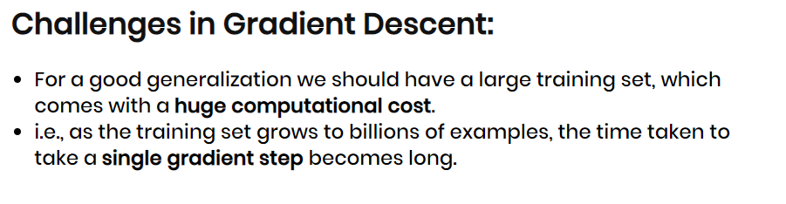
Gradient Descent Algorithm - Issues
Note:
The smaller learning rate the longer GD converges, or may reach maximum iteration before reaching the optimum point
If learning rate is too big the algorithm may not converge to the optimal point (jump around) or even to diverge completely.

Slide 108
Stochastic Gradient Descent- Algorithm
Stochastic Gradient Descent is the extension of Gradient Descent.
Any Machine Learning/ Deep Learning function works on the same objective function f(x) to reduce the error and generalize when a new data comes in.
This is a type of gradient descent which processes 1 training example per iteration.
Parameters can get updated even for one data level of processing also.
Hence this is quite faster than batch gradient descent. But again, when the number of training examples is large.
It replaces the actual gradient (calculated from the entire data set) by an estimate thereof (calculated from a randomly selected subset of the data)
In Gradient Descent, there is a term called “batch” which denotes the total number of samples from a dataset that is used for calculating the gradient for each iteration.
In SGD, it uses only a single sample, i.e., a batch size of one, to perform each iteration. The sample is randomly shuffled and selected for performing the iteration.
So, in SGD, we find out the gradient of the cost function of a single example at each iteration instead of the sum of the gradient of the cost function of all the examples.

Slide 109
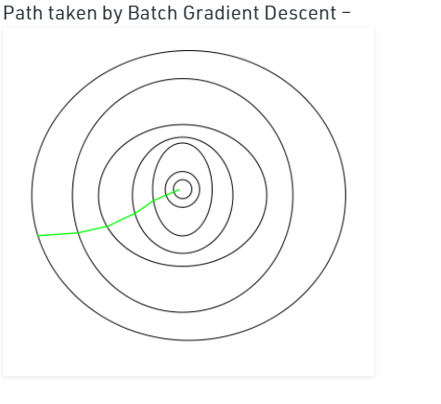
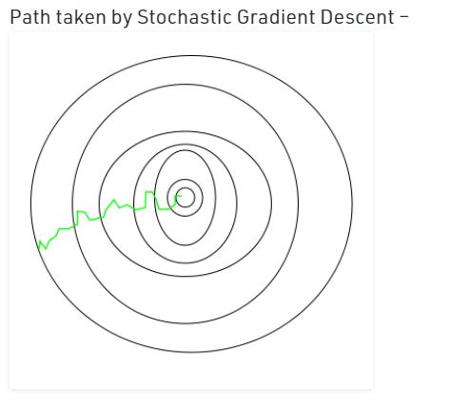
Stochastic Gradient Descent- Algorithm
The path travelled by SGD will be more noisy than GD, But as long as we reach the minima and with significantly shorter training time.

Slide 110
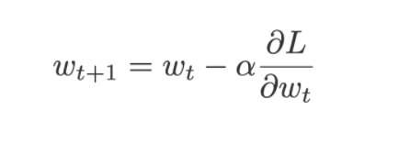
Stochastic Gradient Descent- Algorithm
The advantages of Stochastic Gradient Descent are:
Efficiency.
Ease of implementation (lots of opportunities for code tuning).
The disadvantages of Stochastic Gradient Descent include:
SGD requires a number of hyperparameters such as the regularization parameter and the number of iterations.
SGD is sensitive to feature scaling.
Note:
SGD updates the current weight using the current gradient ∂L/∂w multiplied by some factor called the learning rate, α.

Slide 111
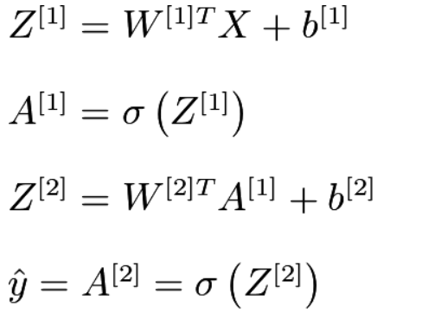
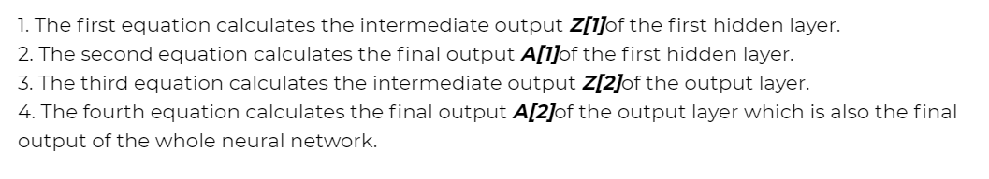
Shallow Networks
Shallow neural networks give us basic idea about deep neural network which consist of only 1 or 2 hidden layers. Understanding a shallow neural network gives us an understanding into what exactly is going on inside a deep neural network A neural network is built using various hidden layers. Now that we know the computations that occur in a particular layer, let us understand how the whole neural network computes the output for a given input X. These can also be called the forward-propagation equations.

Slide 112
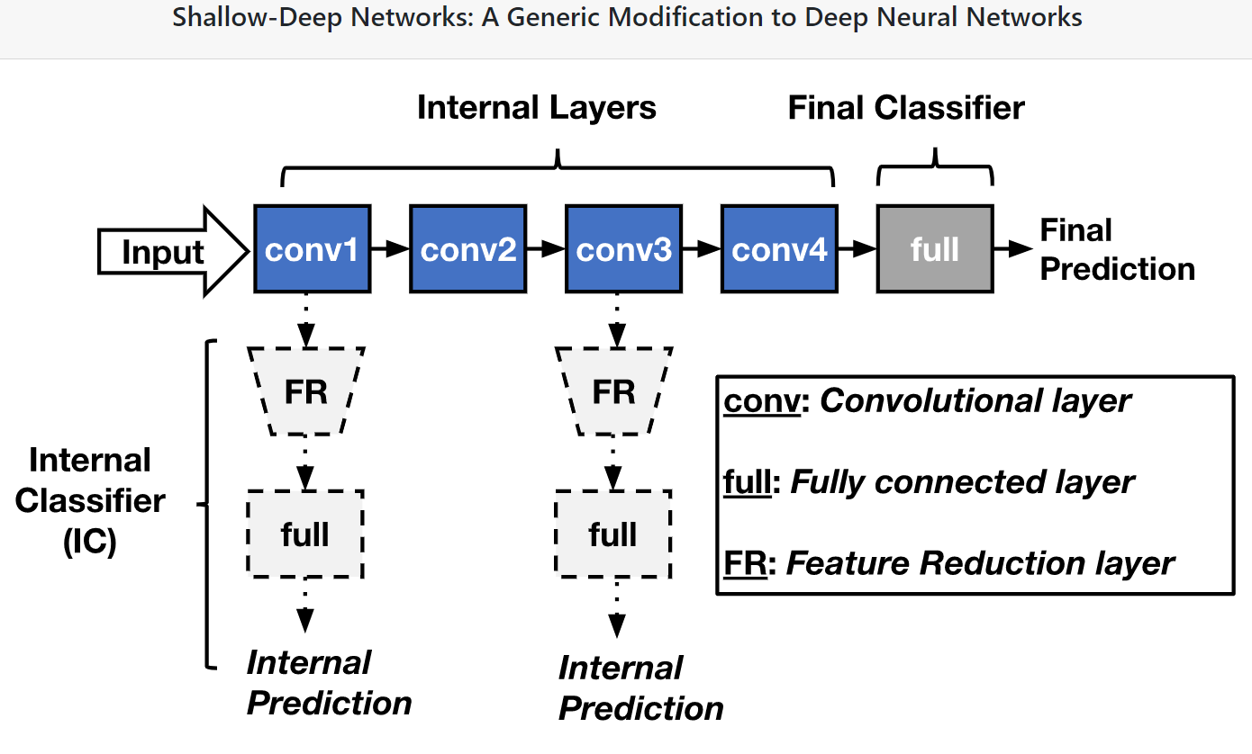
Shallow Networks

Slide 113
Shallow Networks
Difference Between a Shallow Net & Deep Learning Net:
Sl.No | Shallow Net’s | Deep Learning Net’s
1 | One Hidden layer(or very less no. of Hidden Layers) | Deep Net’s has many layers of Hidden layers with more no. of neurons in each layers
2 | Takes input only as VECTORS | DL can have raw data like image, text as inputs
3 | Shallow net’s needs more parameters to have better fit | DL can fit functions better with less parameters than a shallow network
4 | Shallow networks with one Hidden layer (same no of neurons as DL) cannot place complex functions over the input space | DL can compactly express highly complex functions over input space
5 | The number of units in a shallow network grows exponentially with task complexity. | DL don’t need to increase it size(neurons) for complex problems
6 | Shallow network is more difficult to train with our current algorithms (e.g. it has issues of local minima etc) | Training in DL is easy and no issue of local minima in DL

Slide 114

Neural Networks
As
Universal Function Approximation
The output to be predicted is GENDER from the inputs Heights & width.
Without Activation part
h₁ is a linear function of both weight and height with parameters w₁, w₂, and the bias term b₁. Therefore mathematically,
h₁ = w₁*weight + w₂*height + b₁
Similarly
h2 = w₃*weight + w₄*height + b₂
we realize that o1 is also a linear function of h₁ and h2, and therefore depends linearly on input attributes weight and height as well.

Slide 115
Neural Networks -
Universal Function Approximation - Continued
The above equations (in previous slide) seems to be Linear, but we need a Universal Approximator which approximates non linear data’s also
This is where activation layers come into play.
An activation layer is applied right after a linear layer in the Neural Network to provide non-linearities.
Non-linearities help Neural Networks perform more complex tasks.
An activation layer operates on activations (h₁, h₂ in this case) and modifies them according to the activation function provided for that particular activation layer. Activation functions are generally non-linear except for the identity function.
Some commonly used activation functions are ReLu, sigmoid, softmax, etc.
With the introduction of non-linearities along with linear terms, it becomes possible for a neural network to model any given function approximately on having appropriate parameters(w₁, w₂, b₁, etc in this case). The parameters converge to appropriateness on training suitably.

Slide 116
Points to Remember – Unit 1
Why we need ANN?
Types of Learning/Training
Linear models
Perceptron, Regression, SVM
Issues in Linear models
Need for Multi Layer networks (Linear inseparable issues)
Back Propagation Network
Gradient descent
Stochastic Gradient Descent
Shallow Networks
Universal Function Approximation

Slide 117

Dr. V. Vedanarayanan B.E., M.E., PhD
Assistant Professor, Department of ECE,
School of Electrical and Electronics
Sathyabama Institute of Science and technology
Vedanarayanan.etc@sathyabama.ac.in
This Photo by Unknown Author is licensed under CC BY

